Slide 2
In vitro layer-specific Diffusion Weighted Imaging in human primary visual cortex
Michiel Kleinnijenhuis
Brain Circuitry and its Disorders
Doorwerth, 9 June 2011

Slide 3
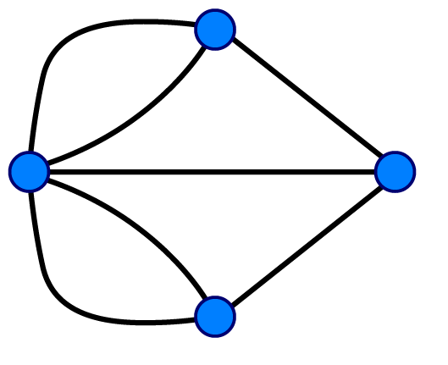
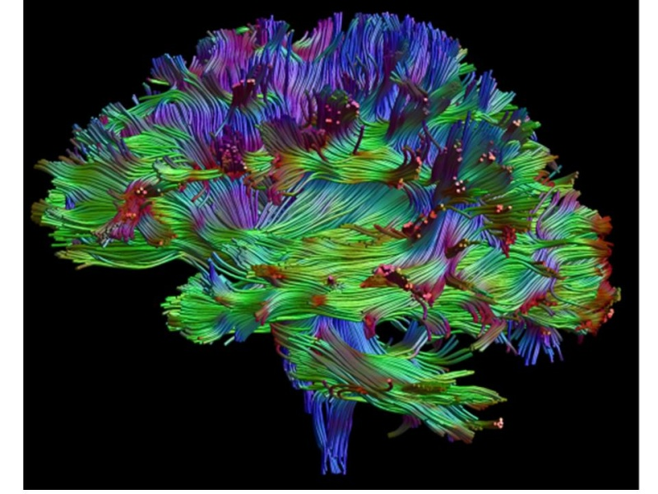
Networks…
Cortical
area
WM circuitry investigated with DWI:
DWI tractography ➔ anatomical networks
Network analysis in disease
Stroke (Crofts et al., NI2010)
AD (He et al., JNS 2008)
Schizophrenia (Basset et al., JNS 2008)
WM tract

Slide 4
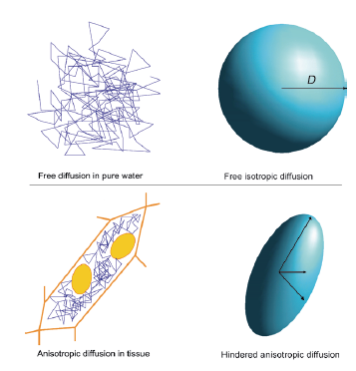
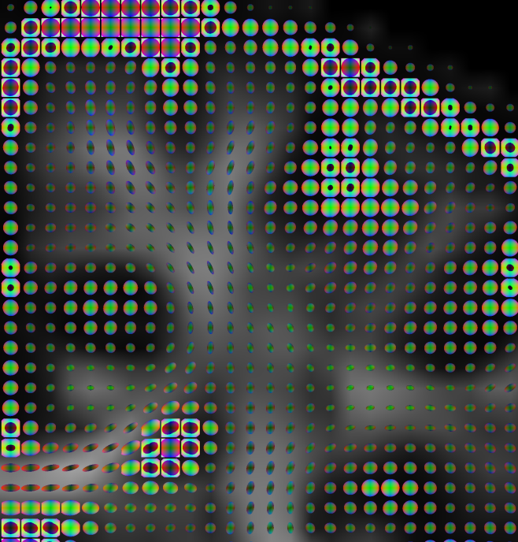
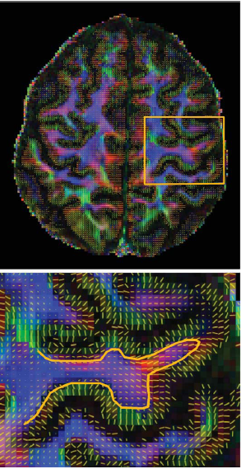
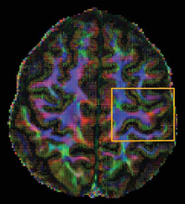
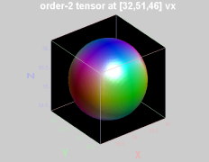
Anisotropy
anisotropic
“In the cortex, diffusion is isotropic”
2 mm voxels
1 mm voxels (7T system)
GM
I-S
A-P
L-R
Heidemann et al., MRM 2010
Sikma, K-J., Thesis defense, May 2011
WM

Slide 5
Hypothesis
Cortical layers can be distinguished on the basis of their diffusion properties
The stria of Gennari (V1) has a large tangential diffusion component

Slide 6
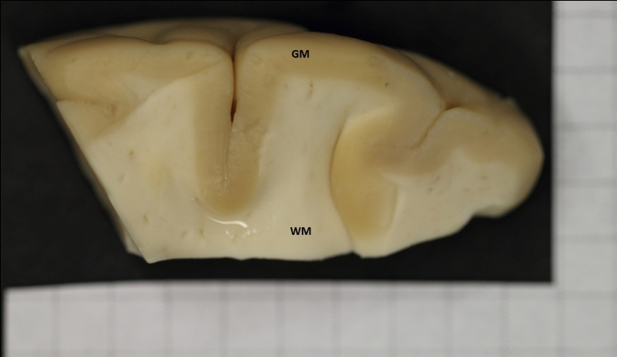
Methods II: MRI
Human brain tissue samples (1 × 1 × 3 cm)
Cortex (V1) + WM;
post-mortem interval 15h
MRI: 11.7 T animal system
DWI – 0.3 mm isotropic
Anatomical – 0.1 mm isotropic
Histology: myelin stain, Luxol Fast Blue

Slide 7
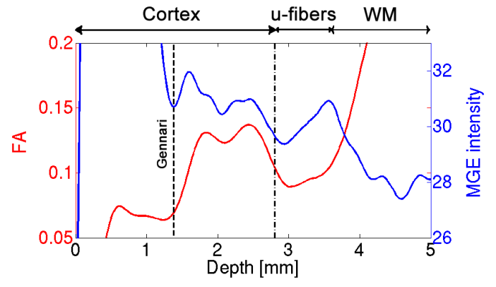
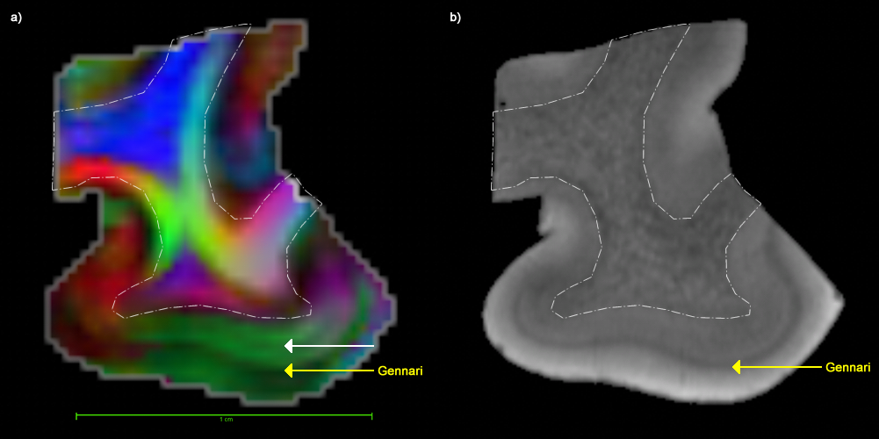
Results I: Fractional Anisotropy
FA is non-uniform over layers
I-S
A-P
L-R

Slide 8
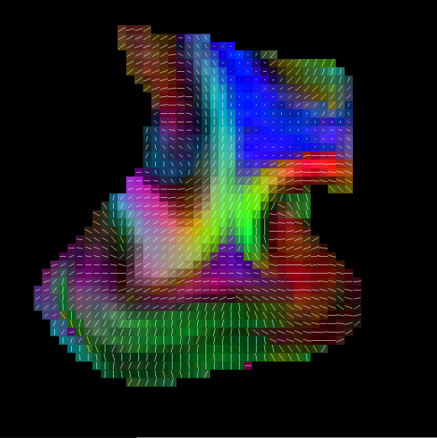
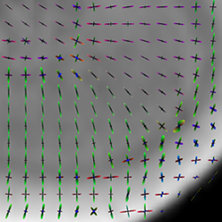
Results II: diffusion directions
WM
U-fibers
Deep cortical layers
Gennari
Superficial layers
layer I fully tangential

Slide 9
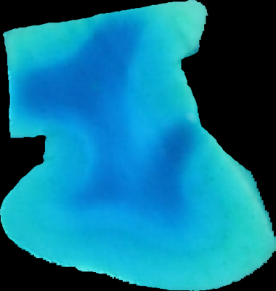
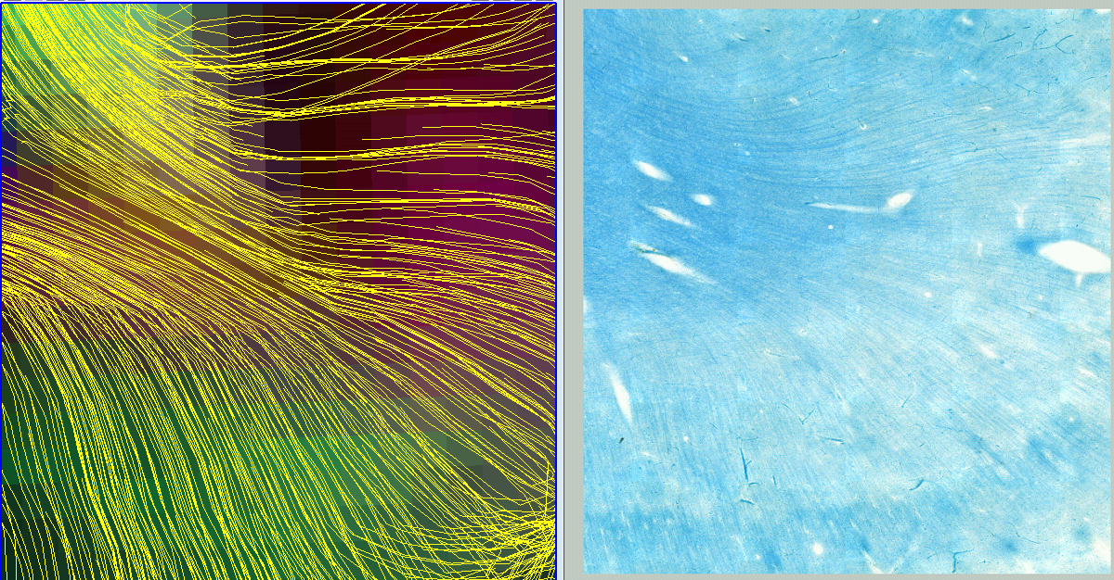
Results III: tractography and histology

Slide 10
Discussion and conclusion
Our findings are a first step in understanding diffusion properties within the cortex
Usefulness for tractography and networks?
➔ informative for cortical endpoints
➔ presumed isotropic tangential component within layers
anisotropic
and layer-specific
“In the cortex, diffusion is isotropic”

Slide 11





Thanks!
Anatomy: Anne-Marie van Cappellen van Walsum
Kees-Jan Sikma
Valerio Zerbi
Jos Dederen
Dirk Ruiter
DCCN: Markus Barth
David Norris
Pathology: Benno Küsters
Radiology: Andor Veltien
MIRA/UTwente: Kees Slump
Bruker BioSpec 11.7T: Investment grants NWO middelgroot 40-00506-90-0602 and NWO BIG (VISTA) to A.Heerschap
VIP Brain Networks

Slide 12
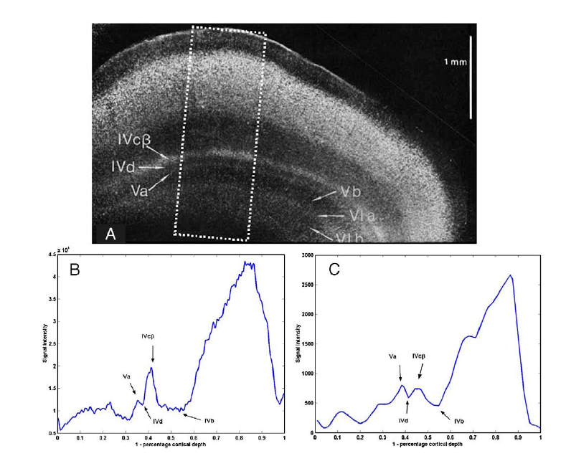
Additional
Blackwell et al., NI 2009

Slide 13
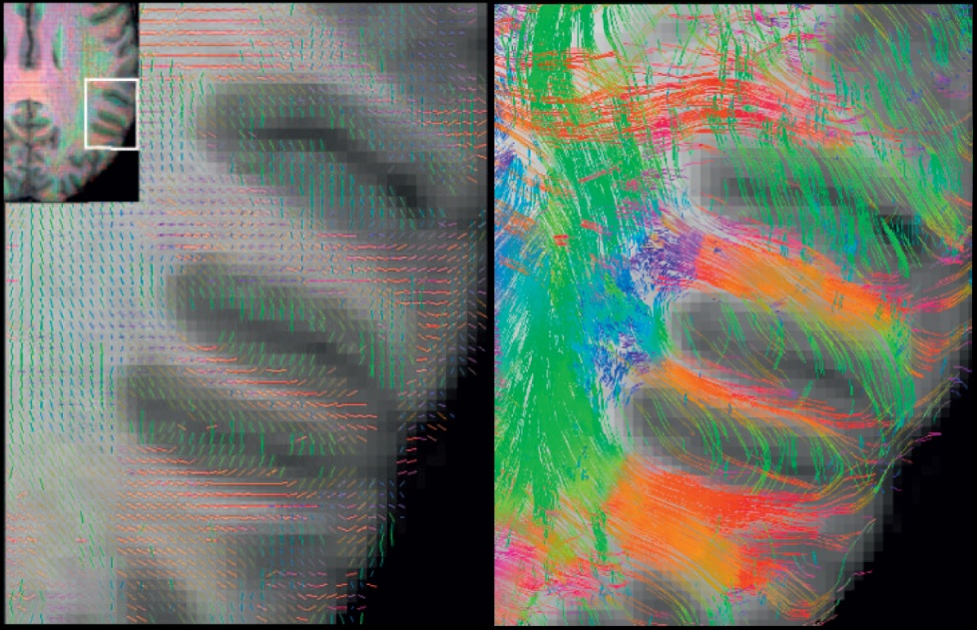
Additional
Heidemann et al., ISMRM 2011, P1957

